Slide 1
Surface Area

Slide 2
Surface Area
Learning Intentions
Success Criteria
By the end of this lesson, students will be able to:
Calculate the surface area for a range of 3-dimensional shapes
Name a categorise 3-dimensional shapes
Use the appropriate units when working with 3-dimensional shapes.
I will know that I have been successful if I can:
Define surface area in my own words
Apply the correct formula
Break shapes into their composite parts to help determining the surface area

Slide 3
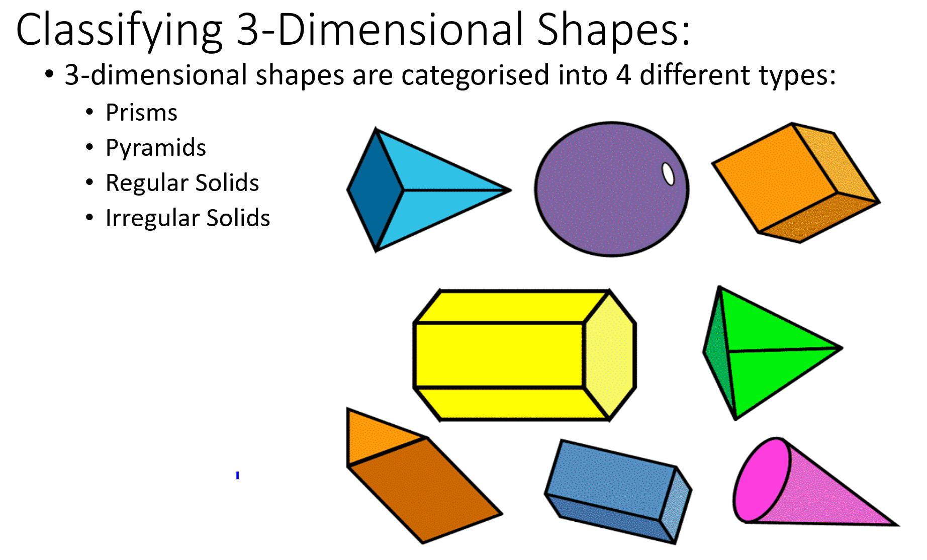
24
7
30
Topic: 3D Shapes and Surface Area
EQ: How do I find the surface area of a 3D shape?

Slide 4
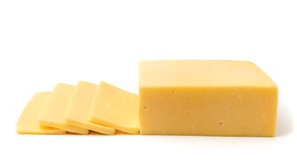
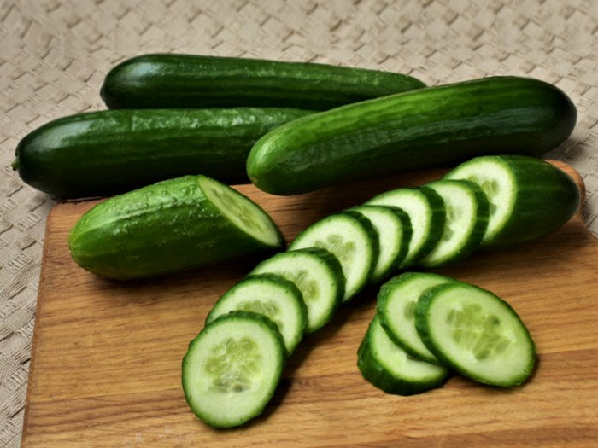
Prisms:
Prisms are solids which have a uniform cross-sectional area. i.e. if you cut the solid across its cross-section, you will have the same face repeated.

Slide 5
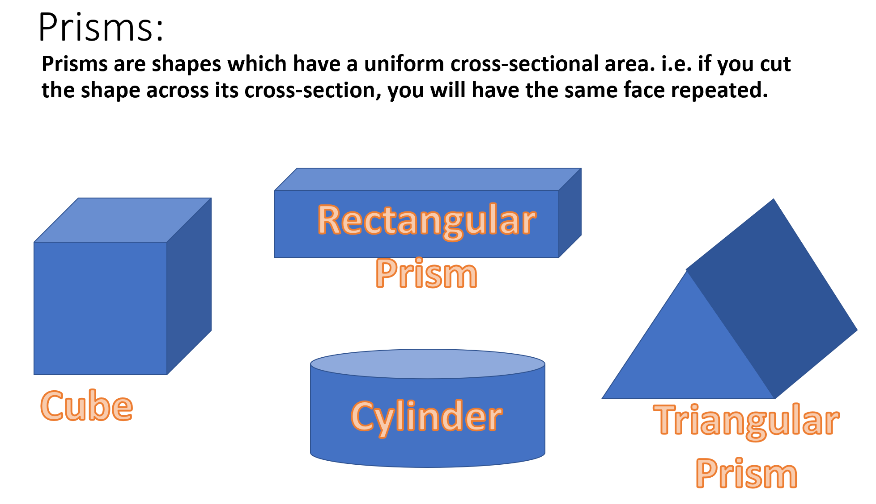
24
7
30
Topic: 3D Shapes and Surface Area
EQ: How do I find the surface area of a 3D shape?

Slide 6
Prisms:
Prisms are shapes which have a uniform cross-sectional area. i.e. if you cut the shape across its cross-section, you will have the same face repeated.
Pentagonal Prism
Irregular Prism

Slide 7
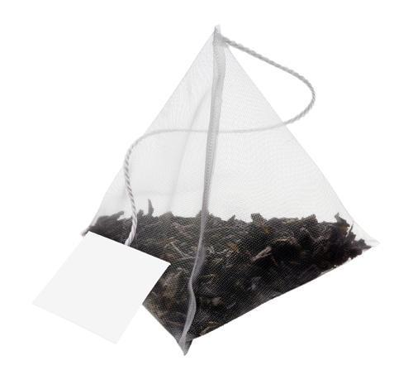
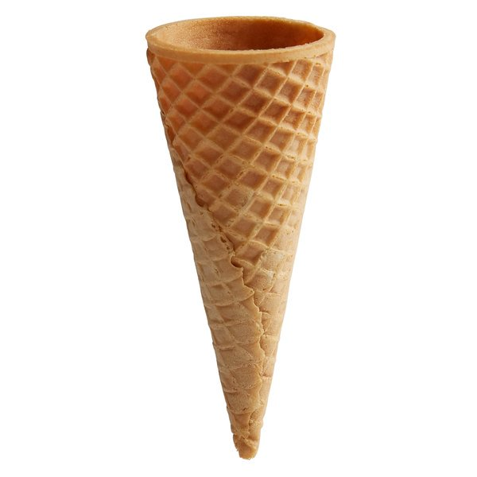
Pyramids:
Pyramids are solids which have a base and then a single point above the middle of this base.

Slide 8
Pyramids:
Pyramids are solids which have a base and then a single point above the middle of this base.
Square-based Pyramid
Hexagonal-based Pyramid
Triangle-based Pyramid

Slide 9
Pyramids:
Pyramids are solids which have a base and then a single point above the middle of this base.
An important feature of pyramids is they have a perpendicular height. Perpendicular means a right angle, so this is the height measured at a right angle to the base.
This is used to determine the volume of these shapes.
We will briefly touch on volume of pyramids this unit, but it is not our primary concern.
Cone

Slide 10
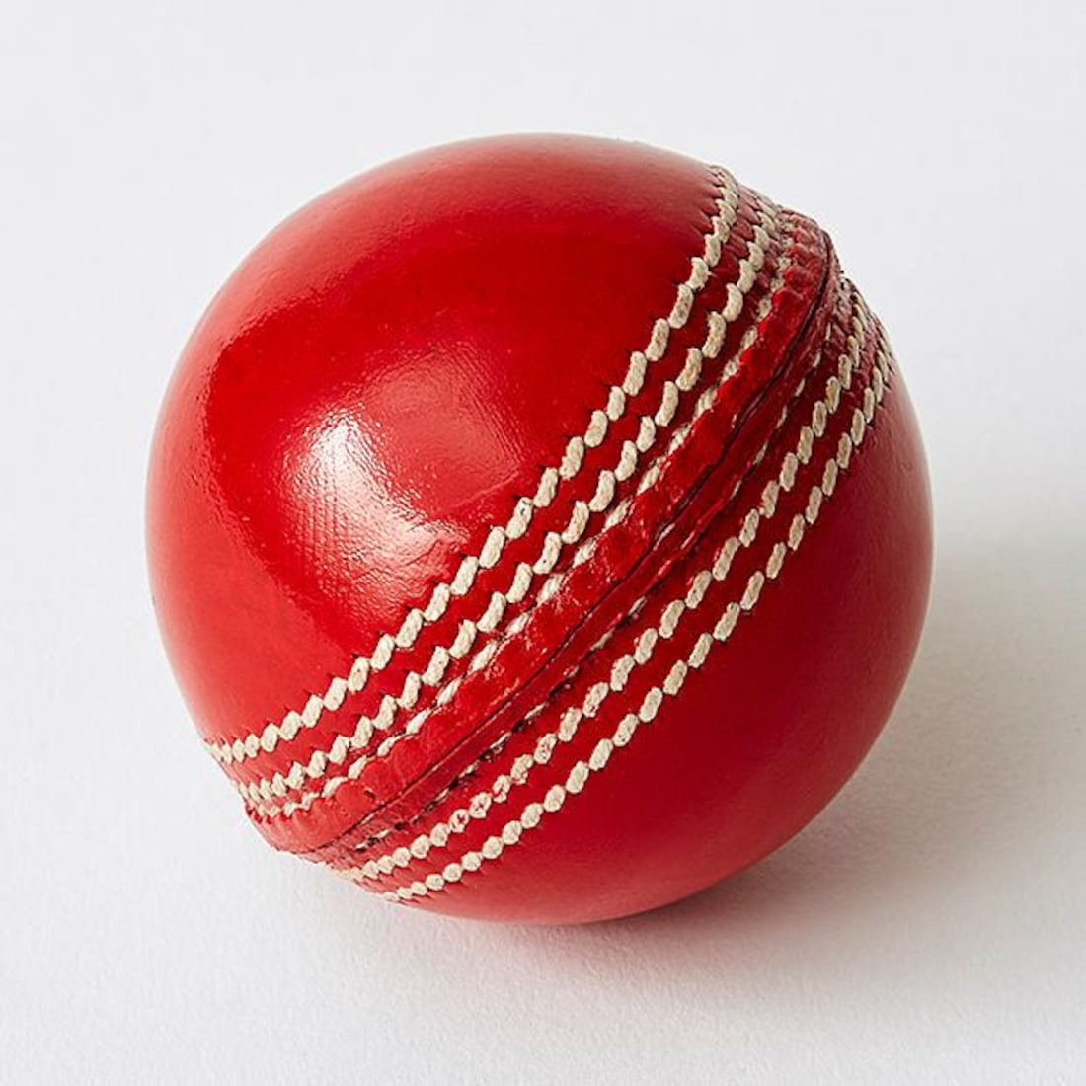
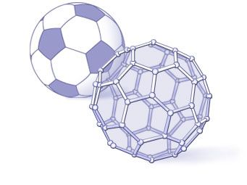

Regular Solids
Regular solids are other solids which have a consistency and equal measure to them. This usually means repeated faces.

Slide 11
Regular Solids
We are only going to be considering spheres in this unit.

Slide 12
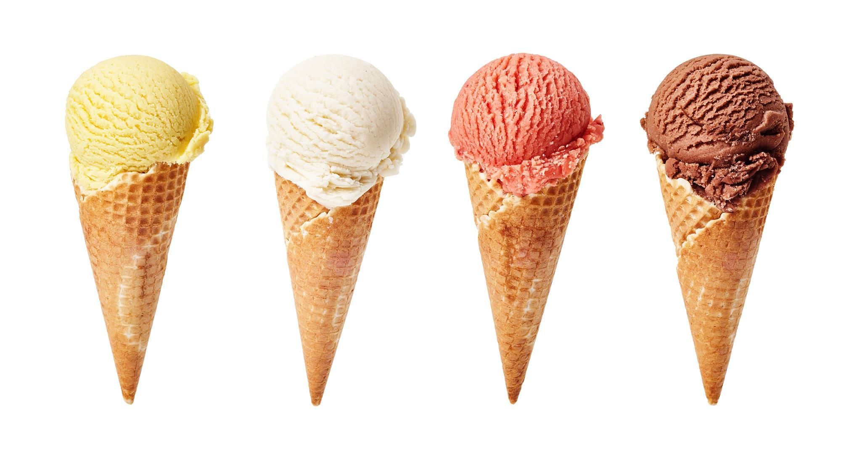
Irregular Solids
Irregular solids are the 3-dimensional equivalent of composite shapes. They are made up of a mix of any and all of the above shapes.

Slide 13

Surface Area
Surface area is the total area on the outside of a 3-dimensional solid.
It is measured in square units as it is a measurement of area.
Consider the present on the right
The surface area is essentially the area of wrapping paper that you would need to completely cover it, with no overhang and nothing uncovered.
The surface area is equal to the area of all of the faces that make the 3-dimensional shape.

Slide 14
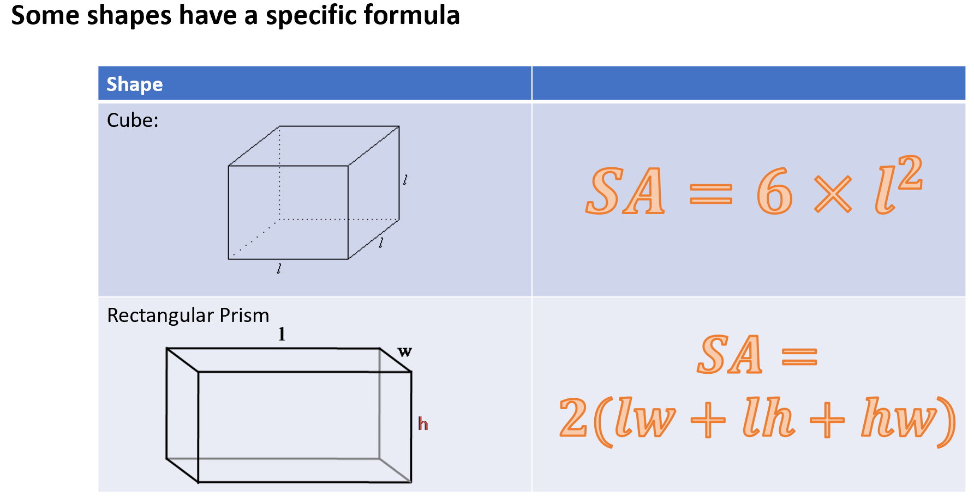
24
7
30
Topic: 3D Shapes and Surface Area
EQ: How do I find the surface area of a 3D shape?
How to calculate surface area?

Slide 15
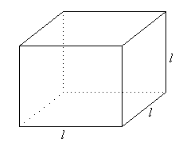
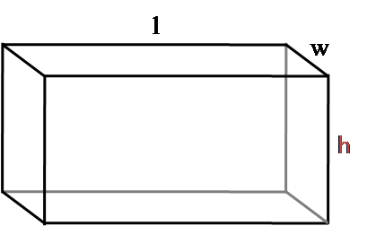

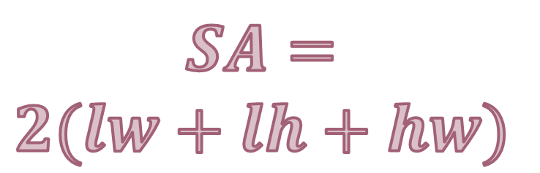
How to calculate surface area:
Some shapes have a specific formula
Shape
Cube:
Rectangular Prism
$$SA=6×l^{2}$$
$$SA=$$
$$2(lw+lh+hw)$$

Slide 16
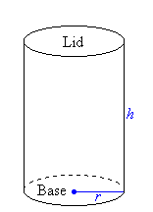
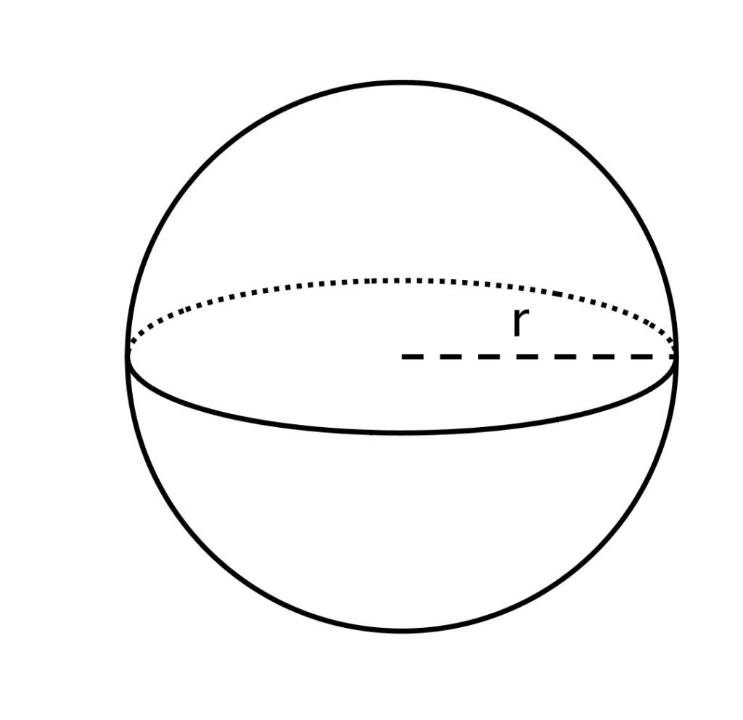


How to calculate surface area:
Some shapes have a specific formula
Shape
Cylinder:
Sphere:
$$SA=2πr^{2}$$
$$+2πrh$$
$$SA=4πr^{2}$$

Slide 17
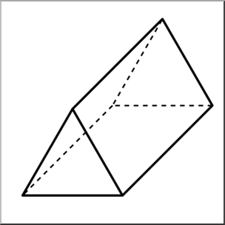
How to calculate surface area:
Other shapes will need you to calculate every side individually
Step 1: Identify and label every unique side. If there are repeat sides, indicate they are the same.
Step 2: Work out the area of each individual unique side.
Step 3: Add all of the surface areas together
13 cm
15 cm
15 cm
25 cm
15 cm

Slide 18
How to calculate surface area:
Other shapes will need you to calculate every side individually
Step 1: Identify and label every unique side. If there are repeat sides, indicate they are the same.
2
1
13 cm
2
15 cm
15 cm
1
25 cm
2
15 cm

Slide 19
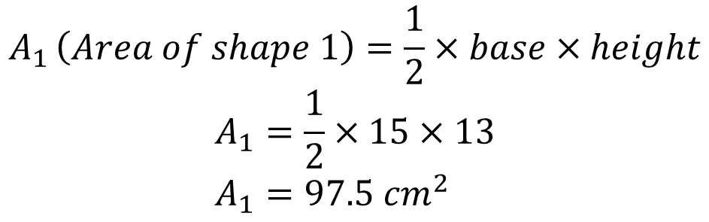
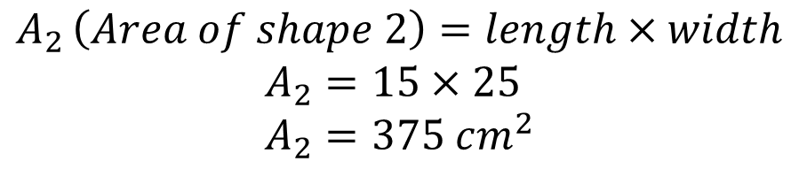
How to calculate surface area:
Other shapes will need you to calculate every side individually
Step 2: Work out the area of each individual unique side.
2
1
13 cm
$$A_{1 }\left(Area of shape 1\right)=\frac{1}{2}×base×height$$
$$A_{1}=\frac{1}{2}×15×13 \\ A_{1}=97.5 cm^{2}$$
2
15 cm
15 cm
1
25 cm
2
$$A_{2 }\left(Area of shape 2\right)=length×width$$
$$A_{2}=15×25 \\ A_{2}=375 cm^{2}$$
15 cm

Slide 20

How to calculate surface area:
Other shapes will need you to calculate every side individually
Step 3: Add all of the surface areas together
2
1
13 cm
$$S.A. =2×A_{1}+3×A_{2}$$
$$S.A. =2×97.5+3×375$$
$$S.A. =195+1125 \\ S.A. =1320 cm^{2}$$
2
15 cm
15 cm
1
25 cm
2
15 cm

Slide 21
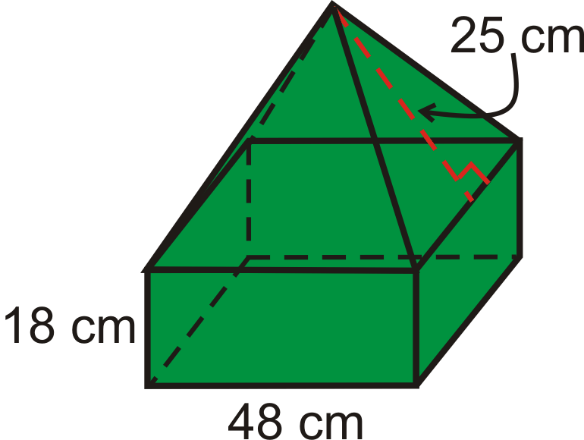
To calculate the surface area of a composite solid:
Step 1: Identify and label every unique side. If there are repeat sides, indicate they are the same.
Step 2: Work out the area of each individual unique side.
Step 3: Add all of the surface areas together

Slide 22
To calculate the surface area of a composite solid:
Step 1: Identify and label every unique side. If there are repeat sides, indicate they are the same.
3
1
2

Slide 23
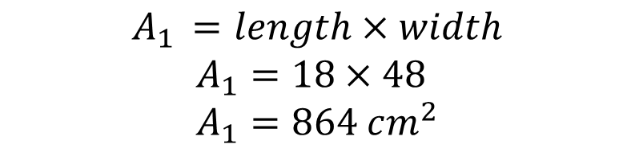
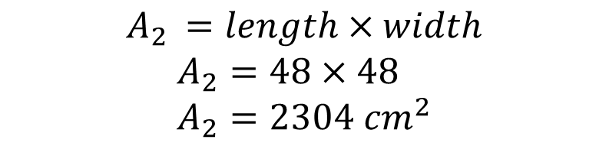
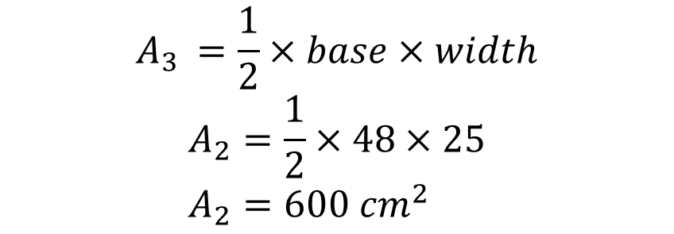
Step 2: Work out the area of each individual unique side.
$$A_{1 }=length×width$$
$$A_{1}=18×48 \\ A_{1}=864 cm^{2}$$
3
$$A_{2 }=length×width$$
$$A_{2}=48×48 \\ A_{2}=2304 cm^{2}$$
$$A_{3 }=\frac{1}{2}×base×width$$
$$A_{2}=\frac{1}{2}×48×25 \\ A_{2}=600 cm^{2}$$
1
2

Slide 24

Step 3: Add all of the surface areas together
$$S.A. =4×A_{1}+A_{2}+4×A_{3} \\ S.A. =4×864+2304+4×600 \\ S.A. =3456+2304+2400 \\ S.A. =8160 cm^{2}$$
3
1
2

